Slide 1
Chapter 10
File Systems: Interface

Slide 2
Objectives and Outline
OBJECTIVES
To explain the function of file systems
To describe the interfaces to file systems
To discuss file-system design tradeoffs, including access methods, file sharing, file locking, and directory structures
To explore file-system protection
OUTLINE
File Concept
Access Methods
Directory Structure
File-System Mounting
File Sharing
Protection

Slide 3
File Concept
We just think and use
files when we
want to store
something
(logical storage unit)
Users
Applications/Processes
file
file
file
file
file
file
Operating System and its
File System component
floppy disk
Hard
Disk
Mobile
disk
USB Disk
CD
tape

Slide 4
File Concept
Processes
Files
File System Interface
File System
Component
(Sub-System)
mapping
Blocks
Disk
Driver
OS
Hard
Disk
Sectors, etc.

Slide 5
File Concept
0
Contiguous logical address space
(a storage)
Content:
  Data
    numeric
    character
    binary
  Program
file
offset
(address)
sequence of bytes
or records
size-1
User’s (processes’) view of
a file

Slide 6
File Structure
None - sequence of words, bytes
Simple record structure
  Lines
  Fixed length
  Variable length
Complex Structures
  Formatted document
  Relocatable load file
Can simulate last two with first method by inserting appropriate control characters
Who decides:
  Operating system
  Program

Slide 7
File Attributes
Name – only information kept in human-readable form
Identifier – unique tag (number) identifies file within file system
Type – needed for systems that support different types
Location – pointer to file location on device
Size – current file size
Protection – controls who can do reading, writing, executing
Time, date, and user identification – data for protection, security, and usage monitoring
Information about files are kept in the directory structure, which is maintained on the disk

Slide 8
Files and Directories
There are two basic things that are stored on disk as part of the area controlled by the file system
- files (store content)
- directory information (can be a tree): keeps info about files, their attributes or locations
Disk
Directory
attrs
file
attrs
file
filename
filename
filename
attrs
File (content)

Slide 9
File Operations
File is an abstract data type
Common Operations that are supported by the Operating System:
  Create
  Write
  Read
  Reposition within file
  Delete
  Truncate
Open(F_{i}) – search the directory structure on disk for entry F_{i}, and move the content of entry to memory
Close (F_{i}) – move the content of entry F_{i} in memory to directory structure on disk

Slide 10
Open File
Process
OS
Open file table
RAM
X
Loc/attr
Disk
open
Directory
structure
File
X
X
Loc/attr

Slide 11
Open Files
Several pieces of data are needed to manage open files:
  File position pointer: pointer to last read/write location, per process that has the file open
  File-open count: counter of number of times a file is open – to allow removal of data from open-file table when last processes closes it
  Disk location of the file: cache of data access information
  Access rights: per-process access mode information

Slide 12
Open file information
Process
Process
Process
File pointer
File pointer
File pointer
File pointer
File pointer
File pointer
File pos. pointer
File pos. pointer
File pos. pointer
Access Rights
Access Rights
Access Rights
Access Rights
Access Rights
Access Rights
Access Rights
Access Rights
Access Rights
…
…
…
…
…
…
…
…
…
Per process
Open file table
Per process
Open file table
File Location
File Location
File Location
File Location
File-Open count
File-Open count
File-Open count
File-Open count
…
…
Main
memory
…
…
System wide open file table
File on Disk (user’s view)
Byte 0

Slide 13
File Locking
Provided by some operating systems and file systems
Mediates access to a file
Mandatory or advisory:
  Mandatory – access is denied depending on locks held and requested
  Advisory – processes can find status of locks and decide what to do

Slide 14

File Content Types

Slide 15
Access Methods
Sequential Access
read next
write next
reset
no read after last write
(rewrite)
Direct Access
read n
write n
position to n
read next
write next
rewrite n
n = relative block number

Slide 16

Sequential-access File

Slide 17

Simulation of Sequential Access on Direct-access File

Slide 18

Example of Index and Relative Files

Slide 19
Directory Structure
A collection of nodes containing information about all files
Directory
filename
Files
file content (data)
F 1
F 2
F 3
F 4
F n
Both the directory structure and the files reside on disk
Backups of these two structures are kept on tapes

Slide 20
Disk Structure
Disk can be subdivided into partitions
Disks or partitions can be RAID protected against failure
Disk or partition can be used raw – without a file system, or formatted with a file system
Partitions also known as minidisks, slices
Entity containing file system known as a volume
Each volume containing file system also tracks that file system’s info in device DIRECTORY or volume table of contents
As well as general-purpose file systems there are many special-purpose file systems, frequently all within the same operating system or computer.

Slide 21
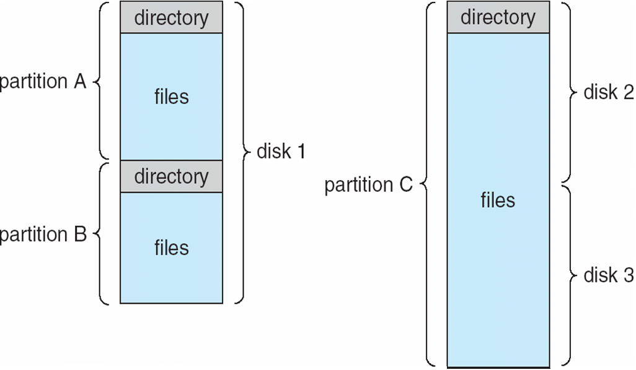
A Typical File-system Organization

Slide 22
Operations Performed on Directory
Search for a file
  Given filename, find out the corresponding directory entry
Create a file
Delete a file
Rename a file
List a directory
  List the names of files in that directory. For each file;
  more information may be printed out.
Traverse the file system
  Starting from root directory, go though all directory entries, including the subdirectories and their entries, recursively.

Slide 23
Organize the Directory (Logically) to Obtain
Goals:
Efficiency – locating a file quickly
Convenient Naming – convenient to users
  Two users can have same name for different files
  The same file can have several different names
Enabling Grouping – logical grouping of files by properties, (e.g., all Java programs, all games, …)

Slide 24

Single-Level Directory
A single directory for all users
Naming problem
Grouping problem

Slide 25

Two-Level Directory
Separate directory for each user
Path name
Can have the same file name for different user
Efficient searching
No grouping capability

Slide 26

Tree-Structured Directories

Slide 27
Tree-Structured Directories (Cont)
Efficient searching
  A pathname indicates where a file is. Parse the pathname and follow
  those subdirectories indicated in the pathname
  “/usr/home/ali/projects/cs342/file.txt”
Grouping Capability
Current directory (working directory)
  cd /spell/mail/prog
  type list

Slide 28
Tree-Structured Directories (Cont)
Absolute or relative path name
Creating a new file is done in current directory
Delete a file
rm <file-name>
Creating a new subdirectory is done in current directory
  mkdir <dir-name>
Example: if in current directory /mail
mkdir count
mail
prog
copy
prt
exp
count
Deleting “mail” ⇒ deleting the entire subtree rooted by “mail”

Slide 29

Acyclic-Graph Directories
Have shared subdirectories and files
shared file
shared subdirectory

Slide 30
Acyclic-Graph Directories (Cont.)
Y
Two different names (aliasing)
If one deletes ⇒ dangling pointer
Solutions:
  Backpointers, so we can delete all pointers
  Variable size records a problem
  Use reference count
New directory entry type
  Link – another name (pointer) to an existing file
  Resolve the link – follow pointer to locate the file
X
Z
W
Shared dir or file
a sequence of entries
a directory
dir
dir
file
file
file
link
file

Slide 31
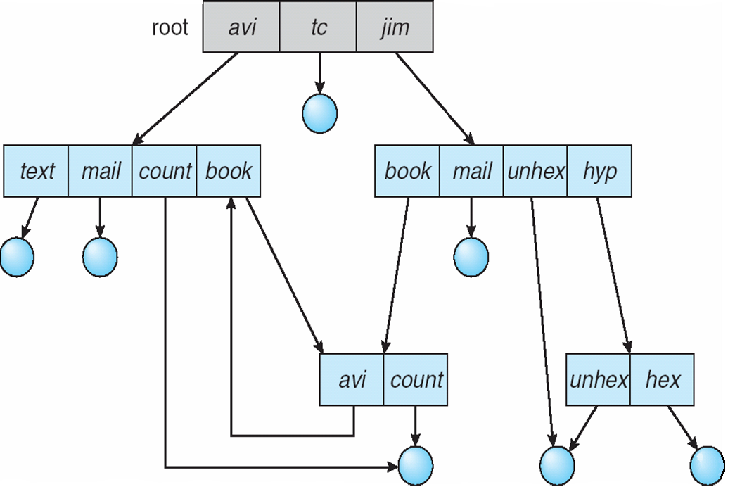
General Graph Directory

Slide 32
General Graph Directory (Cont.)
How do we guarantee no cycles?
  Allow only links to files not subdirectories
  Every time a new link is added use a cycle detection
  algorithm to determine whether it is OK (will not close loop)

Slide 33
File System Mounting
A file system must be mounted before it can be accessed
Mounting a new file system means placing (attaching – connecting) the new file system into a location in the local directory tree (local file system) that becomes accessible at system boot time.
An unmounted file system is mounted at a mount point
Mount point: the place in the local directory tree where the new file system is placed. The root of that file system will be that place in the local file system

Slide 34

(a) Existing. (b) Unmounted Partition
Local file system
New file system
to be mounted

Slide 35
Mount Point
mount point

Slide 36

Local file system appearance after mounting

Slide 37
File Sharing
Sharing of files on multi-user systems is desirable
Sharing may be done through a protection scheme
On distributed systems, files may be shared across a network
Network File System (NFS) is a common distributed file-sharing method

Slide 38
File Sharing
Each user that has an account in the computer has a username and a unique
user ID (UID)
The administrator can create groups. A group may have a set of
usernames (users) associated with it. Each group has a unique group ID (GID)
Example: group os_team: ali, veli, selcuk, ….
File attributes for a file
…
UID (user ID)
GID (group ID)
User (owner) permissions
Group permissions
Other people permissions
……

Slide 39
File Sharing – Multiple Users
Protection
Protection is based on the use of UIDs and GIDs.
Each file has associated protection bits (permissions) for UID and GID.
  User ID: read, write, execute?
  Group ID: read, write, execute?
UIDs identify users, allowing permissions and protections to be per-user
GIDs allow users to be in groups, permitting group access rights

Slide 40
File Sharing – Remote File Systems
Uses networking to allow file system access between systems
  Manually via programs like FTP
  Automatically, seamlessly using distributed file systems
  Semi automatically via the world wide web
Client-server model allows clients to mount remote file systems from servers
  Server can serve multiple clients
  Client and user-on-client identification is insecure or complicated
  NFS is standard UNIX client-server file sharing protocol
  CIFS is standard Windows protocol
  Standard operating system file calls are translated into remote calls
Distributed Information Systems (distributed naming services) such as LDAP, DNS, NIS, Active Directory implement unified access to information needed for remote computing

Slide 41
Distributed File System
Computer B
processes
VFS
Computer A
Computer C
localFS
NFS
processes
File
System B
processes
VFS
VFS
localFS
NFS
localFS
NFS
File
System A
File
System C
Network

Slide 42
Distributed File System
File System view at computer A after remote file systems are mounted
Computer A
processes
File
System A
mount point
File
System B
File
System C

Slide 43
File Sharing – Failure Modes
Remote file systems add new failure modes, due to network failure, server failure
How to recover from failures?
Recovery from failure can involve state information about status of each remote request
  State information: what files are opened; what is the file position pointer, etc.

Slide 44
File Sharing – Consistency Semantics
Consistency semantics specify how multiple users are to access a shared file simultaneously
  Unix file system (UFS) implements:
    Writes to an open file visible immediately to other users of the same open file
  AFS has session semantics
    Writes only visible to sessions starting after the file is closed

Slide 45
Protection
File owner/creator should be able to control:
  what can be done (read, write, execute….)
  by whom (owner, others, group member…)
Types of access (what can be done)
  Read
  Write
  Execute
  Append
  Delete
  List

Slide 46
Access Lists and Groups
Mode of access: read, write, execute
Three classes of users
RWX
a) owner access 7 ⇒ 1 1 1
RWX
b) group access 6 ⇒ 1 1 0
RWX
c) public access 1 ⇒ 0 0 1
Ask manager to create a group (unique name), say G, and add some users to the group.
For a particular file (say game) or subdirectory, define an appropriate access.
owner
group
public
chmod
761
game
Attach a group to a file
chgrp G game

Slide 47

Windows XP Access-control List Management

Slide 48

A Sample UNIX Directory Listing

Slide 49
References
The slides here are adapted/modified from the textbook and its slides: Operating System Concepts, Silberschatz et al., 7th & 8th editions, Wiley.
Operating System Concepts, 7th and 8th editions, Silberschatz et al. Wiley.
Modern Operating Systems, Andrew S. Tanenbaum, 3rd edition, 2009.

